Slide 1
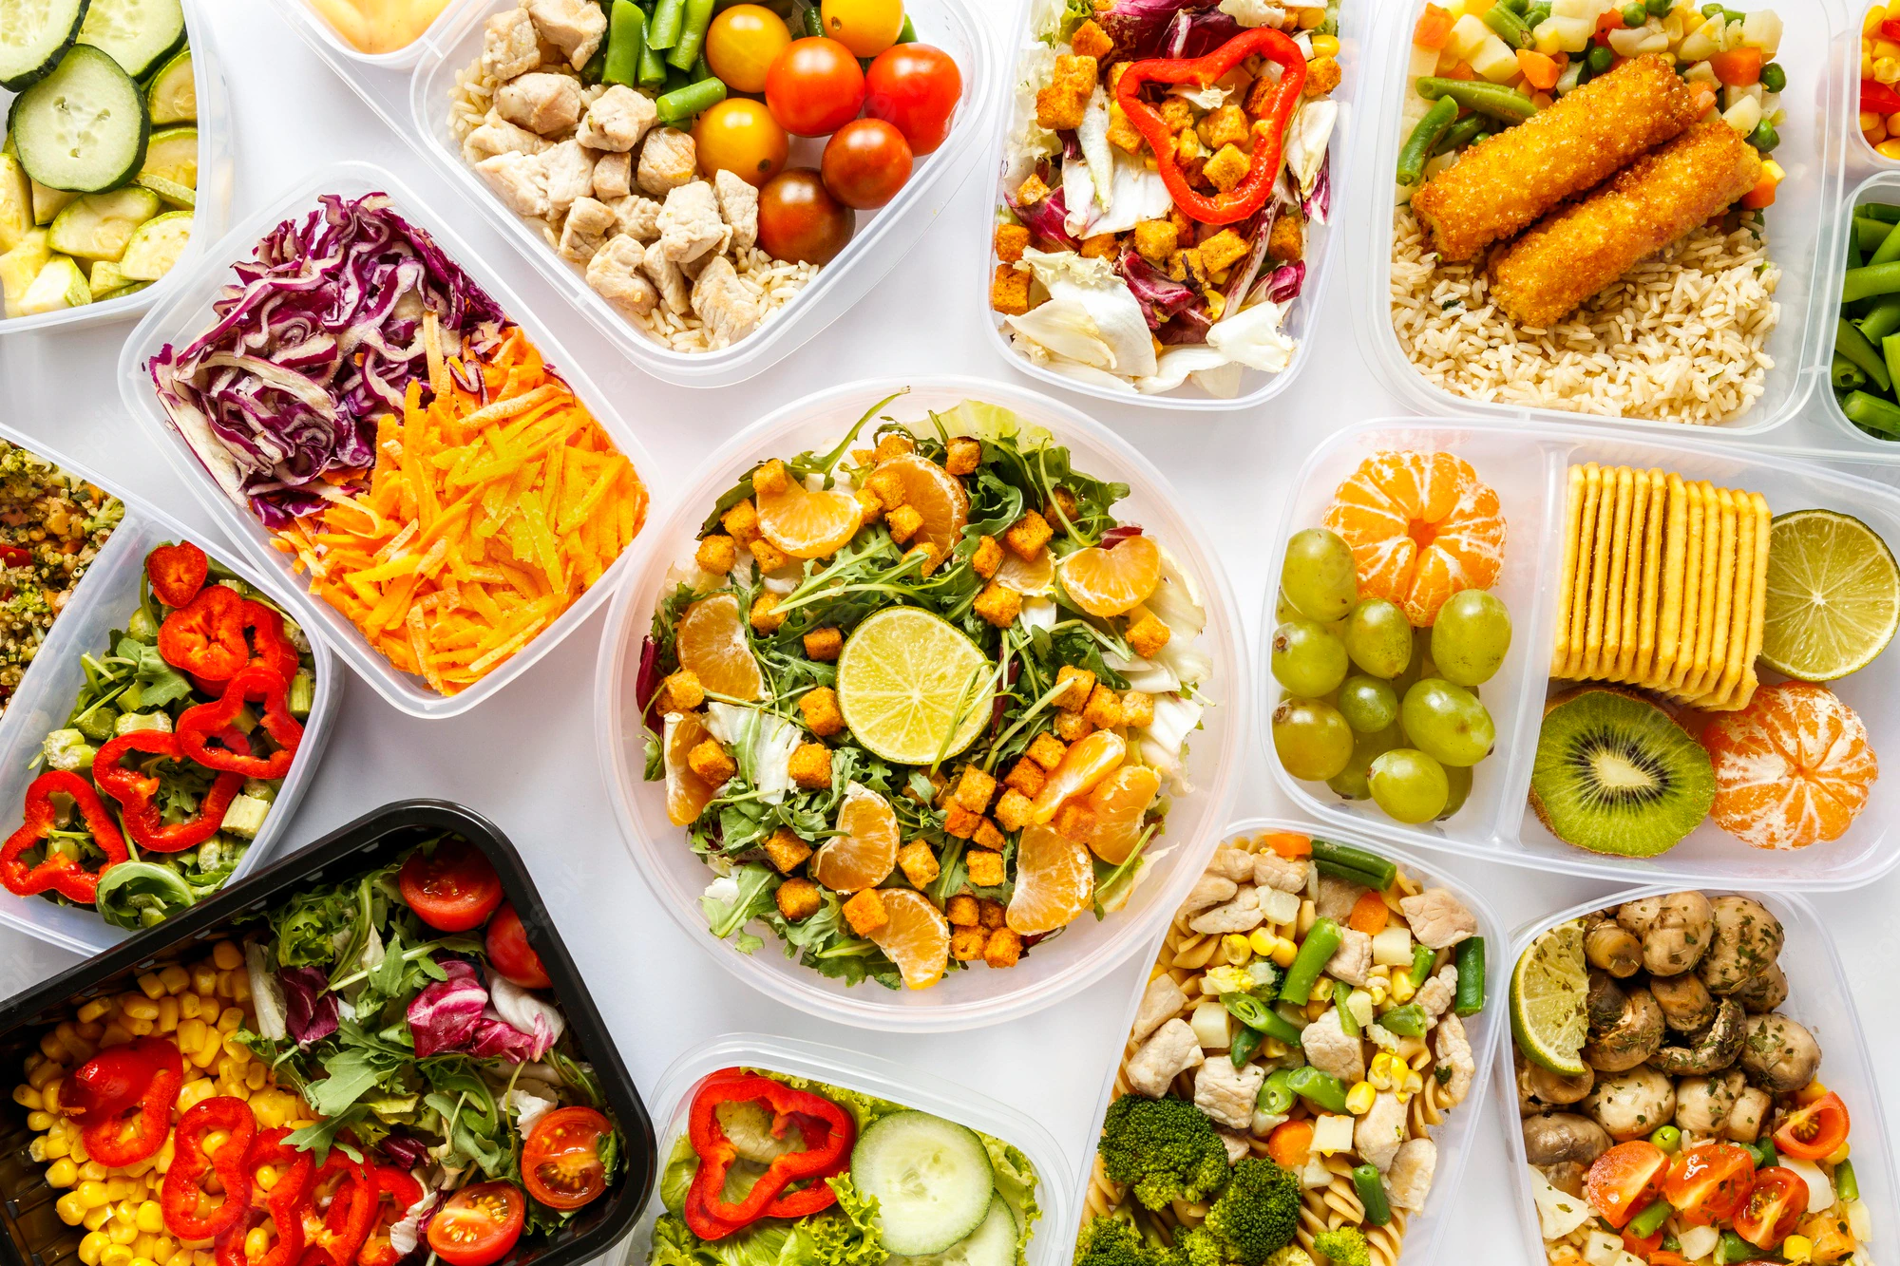
CRAVINGS
FOOD ORDERING APPLICATION
TEAM MEMBERS:
KIRAN GURAWAL
NAINAN DUBEY
PRADEEP LOWANSHI
RUPALI GAJAKOSH
YUKTA NAGLE
GUIDED BY:
MR. JAYNAM SANGHVI

Slide 2
What is Food Ordering System?
A food ordering system is software that lets your restaurant accept and manage orders placed online. An online food ordering system generally has two components – a website or app that allows customers to view the menu and place an order, and an admin interface that enables the restaurant to receive and fulfil customer orders.
Online food ordering systems are a great option for restaurants looking to respond to a rapidly changing operating environment – and most are relatively easy to set up. If you’ve been considering adding an online sales channel to your restaurant but you’re not sure where to start, read on for insights and tips on choosing the right online ordering system for your business.

Slide 3
Technologies used
Java 8
Spring Boot
Spring Security
React & Hooks
React Bootstrap
MySQL
JUnit & Mockito

Slide 4
OBJECTIVE
The general objectives of the study is to develop a reliable, convenient and accurate Food Ordering System. The study has the following specific objectives:
Satisfy customer service.
Able accommodate huge amount of orders at a time.
Security, user-friendliness, accuracy and reliability.
Proper communication between the client and the server and minimize the time of ordering.
Customer satisfaction.
To automatically compute the bill while ordering.
Direct Communication between customer and owner. No third-party involvement

Slide 5
Plan
Design:
Generate a skeleton as per class diagram
TDD Approach:
Identify test cases for each modules
Write failing test cases
Convert the test cases in green
Implemented the case study in incremental manner

Slide 6
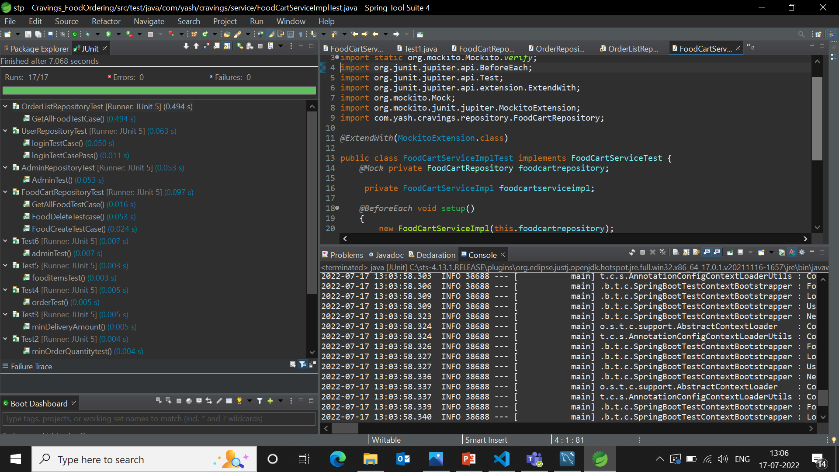
Followed TDD Approach

Slide 7
Modules used in project
ADMIN / OWNER:
Login
View Customers
View Food Items
View food Order
Can update food order status
CUSTOMER:
Register
Login
View Items
Add to cart
View Cart
Place Order
View Order History

Slide 8
FUNCTIONAL REQUIREMENT
The User(Customer ) should be able to login with the required credentials.
The User should be able to view the various food items available on the system.
The user should be able to add the item to the cart.
The user should be able to buy the items in the cart.
The user should be allowed to view his order history.
NON-FUNCTIONAL REQUIREMENT
There should be a secure login system.
The system should be well developed.
The System should be user friendly.
It should be efficient to use.

Slide 9
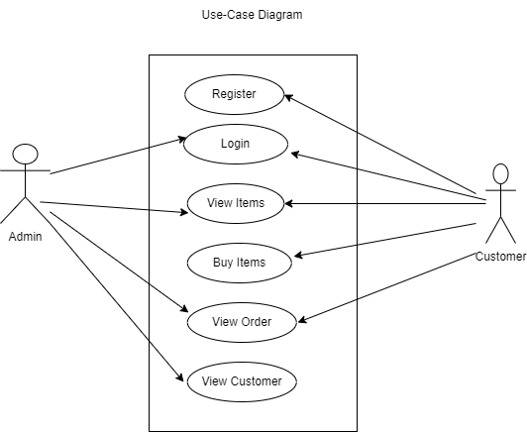
Use-case diagram

Slide 10
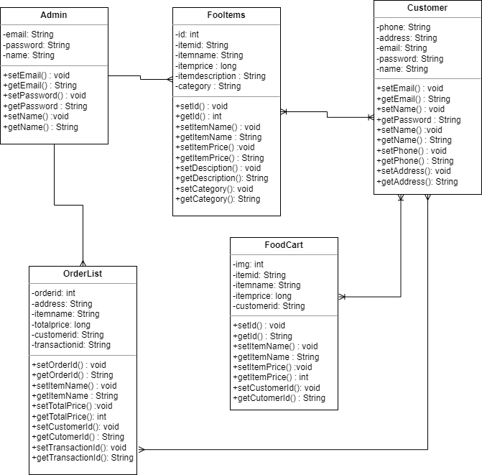
Class Diagram

Slide 11
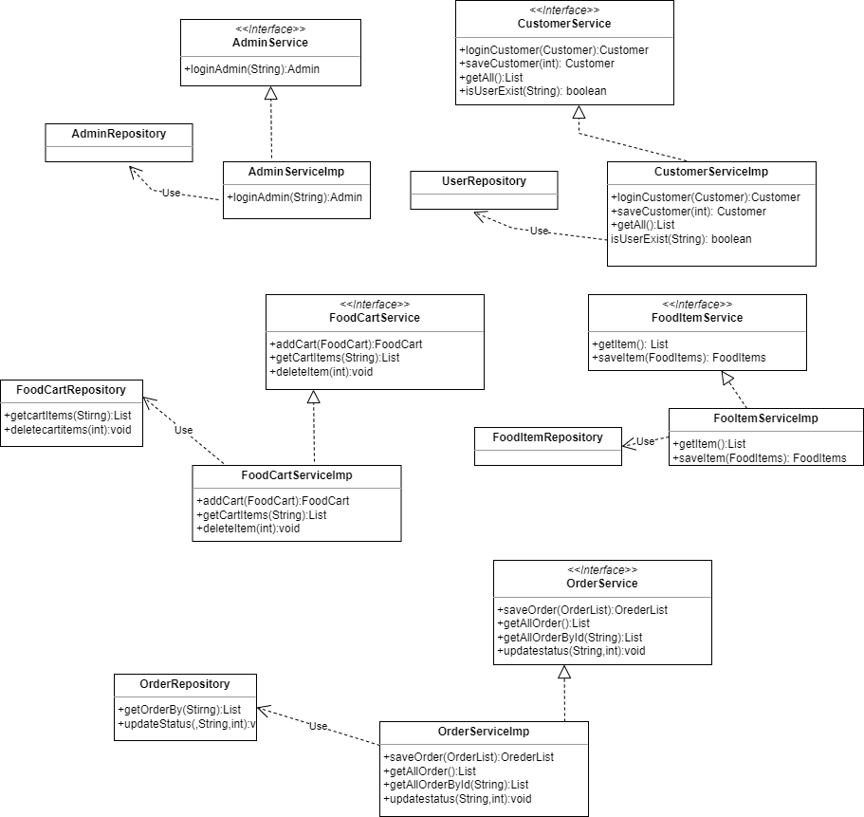
Interface diagram

Slide 12
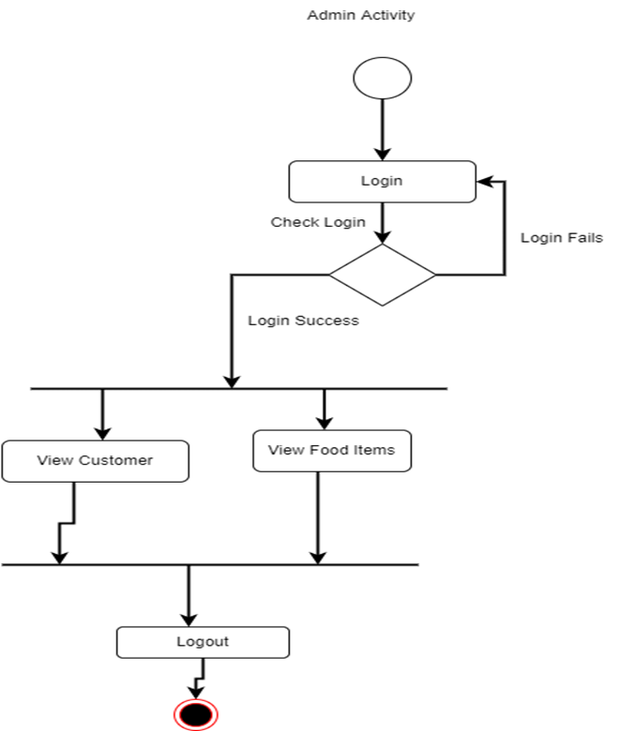
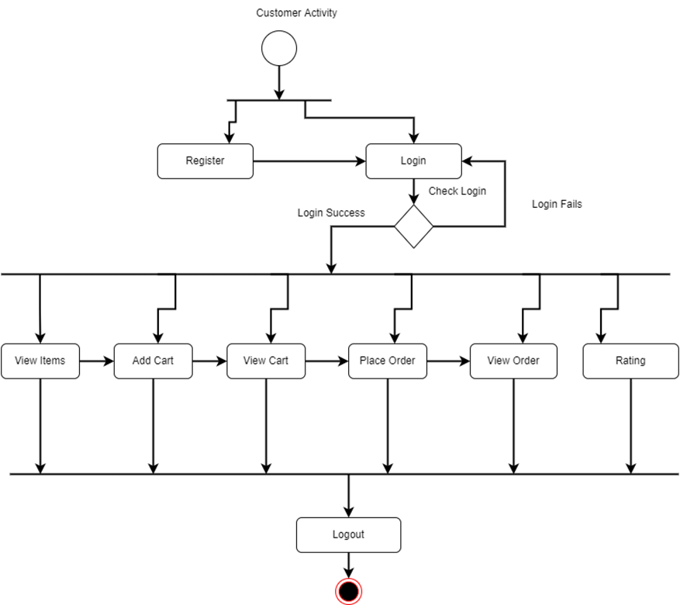
ACTIVITY DIAGRAM

Slide 13
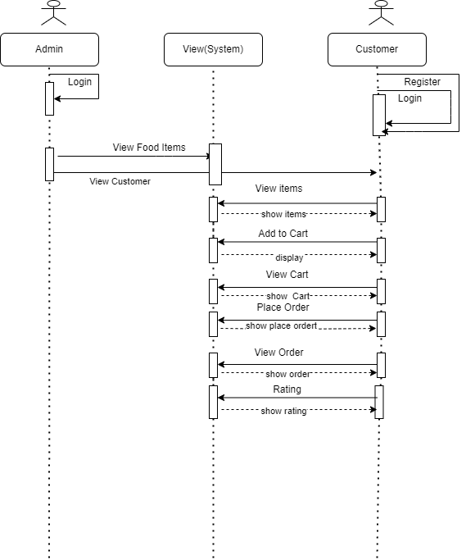
SEQUENCE DIAGRAM

Slide 14
Thank you

